Slide 1
Security in Cloud Computing -
A Survey
Made By:
Vibhav Bhangale

Slide 2
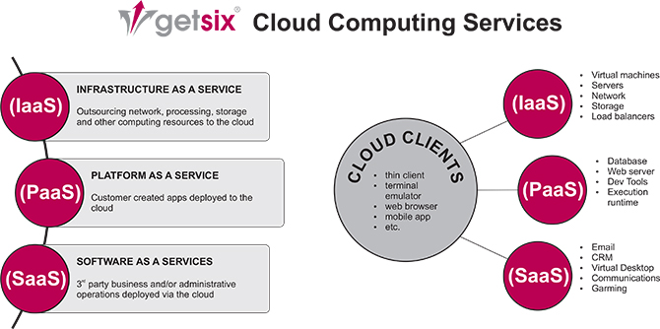
Cloud Computing Models
IAAS
PASS
SAAS

Slide 3
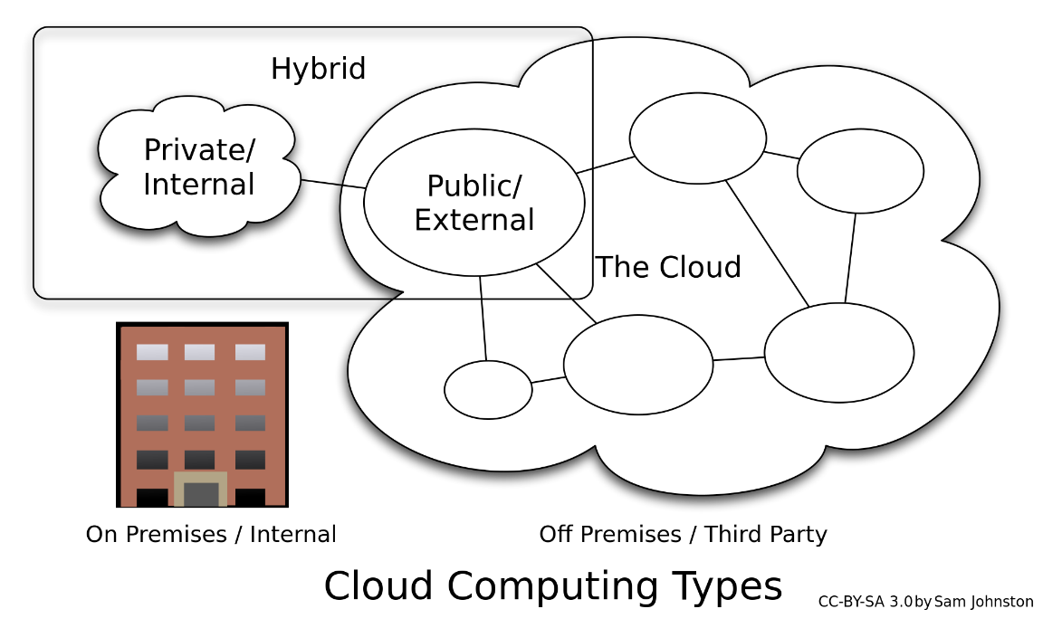
Cloud Computing Deployment Models
PRIVATE CLOUD
PUBLIC CLOUD
HYBRID CLOUD

Slide 4
AREAS OF SECURITY IN CLOUD
Information at rest
Information in transit
Authentication of users, applications
Separation of data
Legal and regulatory problems
Incident response

Slide 5
Encrypting data at rest
Client – Side Encryption
User maintains the key(password)
Provider cannot access the data
User responsible for key storage
Server – Side Encryption
Server maintains the key(password)
Provider can access the data
Key stored on server itself

Slide 6
Encryption models
Modern Encryption Techniques
Searchable Encryption
Homomorphic Encryption
Attribute Based Encryption
Hybrid Encryption

Slide 7
Randomness and Performance Testing of Modern encryption techniques
Tested using NIST test suite
Tested RC4, RC6, AES, DES, 3DES, MARS, Two-Fish, and Blow-Fish.
Comparison based on rejection rate, P-value, time consumption
Level of significance chosen as 0.01
If P-value < 0.01, reject the sequence

Slide 8
RESults
Amazon EC2 | 1 | 2 | 3 | 4
P-value | RC6 | AES | Blowfish | RC4
Rejection Rate | DES | AES | Blowfish | RC4
Time consumption | Blowfish | DES | AES | RC4

Slide 9
Hybrid descast algorithm
Hybrid algorithm for encryption of data
Implements CAST and DES
Uses 2 keys – 128 bit key for CAST and 64 bit key for DES
Averts CAST’s related key attack problem
Relatively slow when encrypting large data.

Slide 10
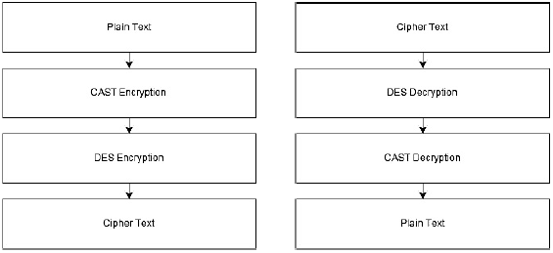
HYBRID DESCAST ALGORITHM
Encyption

Slide 11
TDEASalt
Uses DES and AES
Uses 2 salt values with each block
Increases plain-text sensitivity
Removes direct plaintext and ciphertext mapping
Consumes more time and resources

Slide 12
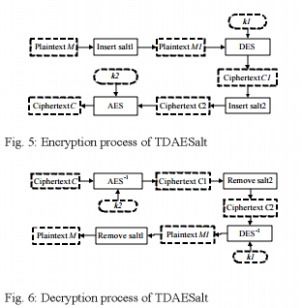
TDAESalt
Image Source: Guo, P. , Su, L. , Ning, L. , & Dan, G. (2013).
Hybrid encryption algorithms in cloud computing.
Information Technology Journal, 12(14), 3015-3019.

Slide 13
references
[1.] Guo, P. , Su, L. , Ning, L. , & Dan, G. (2013). Hybrid encryption algorithms in cloud computing. Information Technology Journal, 12(14), 3015-3019.
[2.] Sengupta, N. , & Chinnasamy, R. (2015). Contriving hybrid descast algorithm for cloud security. Procedia Computer Science, 54, 47-56.
[3.] Kaur, S., & Kaur, A. (2015). Survey of security algorithms in cloud. International Journal of Computer Applications, 115(19), 23-27.
[4.] Mohamed, E. M., El-Etriby, S., & Abdul-kader, H. S. (2012, May). Randomness testing of modern encryption techniques in cloud environment. In Informatics and Systems (INFOS), 2012 8th International Conference on (pp. CC-1). IEEE.

